Slide 1
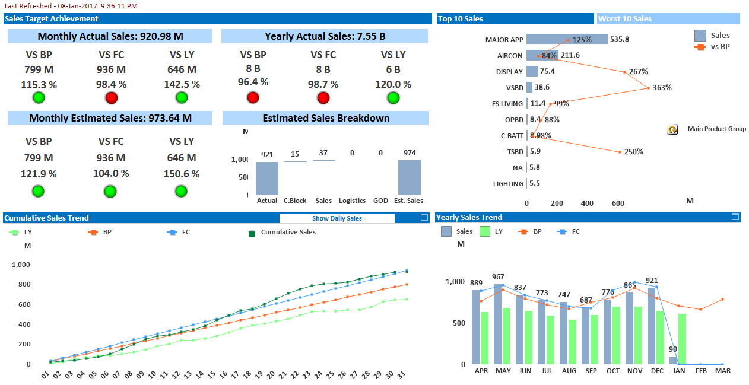
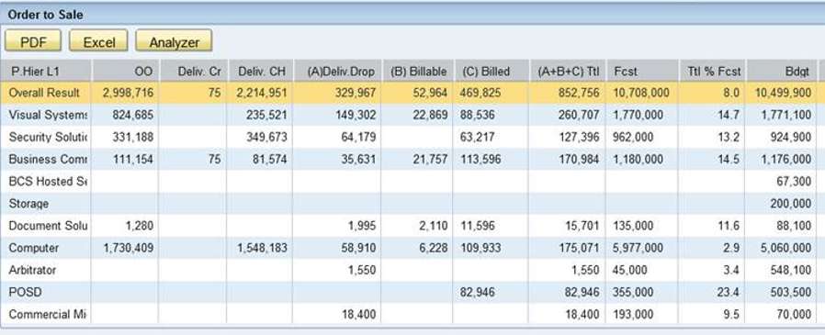
PSSNA Dashboard Update
1
Sales
Filters:
Business Unit
Product Line
Material family
Fiscal Year
Fiscal Quarter
Fiscal Month
Vs PSI
Add Last Month
Sales value/BP achievement level by product categories
Order to Sale (see next slide)
See next slide
Daily sales progression
Monthly actual sales performance against Forecast
Notes:
862-5248

Slide 2
Control Buttons for Filtering/Selecting -Business Unit -Product Line -Material Family Monthly time selector slide bar -Use Psi for Forecast -Show Current Month vs Last month -Replace Estimated sales BreakDown with Order to Sale (magnus Canadian dash) Data: Distribution Channel, Open Orders $, Deliv CR (Delivery Created), Deliv CH (Delivery on Credit Hold), Delivered Drop, Billable, Billed, Sum (Delivered Drop, Billable, Billed, Forecast), %Total/Forecast, Budget, %Total/Budget.
Specs for Sales Dash page

Slide 3
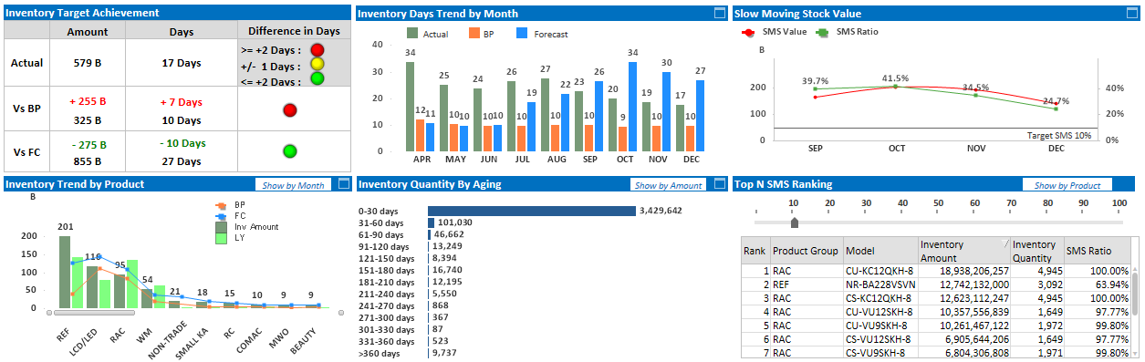
PSSNA Dashboard Update
3
Inventory
Amounts in $ line with Days
Filters:
Business Unit
Product Line
Material family
Fiscal Year
Fiscal Quarter
Fiscal Month
Inventory quantity
by aging periods
Possible to map out
all categories by models
Inventory value by products &
BP/LY/Forecast ratios

Slide 4
Control Buttons for Filtering/Selecting -Business Unit -Product Line -Material Family Monthly time selector slide bar Actual Views of: total Available, Total on Hand, Total Potential(includes incoming) Change INVENTORY Trend Days by month to show $ with a line to show days
Specs for Inventory Dash page

Slide 5
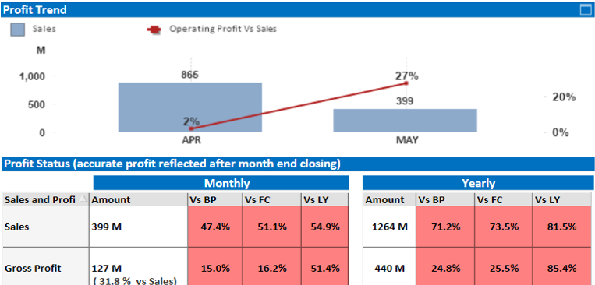
PSSNA Dashboard Update
5
Profitability
Show Actual (Historical and MTD Sales) and Projected Sales (Pipeline) by Month, Quarter, Year
Filters:
Business Unit
Sector
Vertical
Product Line
Material family
Fiscal Year
Fiscal Quarter
Fiscal Month
Add Quarterly

Slide 6
Control Buttons for Filtering/Selecting -Business Unit -Sector -Vertical -Product Line -Material Family Monthly time selector slide bar ADD Quarterly results Calculate Profitability for Pipeline and actual Sales Based on feedback from accounting Actual Sales profitability will be Net Sales - Moving average Cost. Projected Profit will be SalesForce projected sales less salesforce projected cost.
Specs for Inventory Dash page

Slide 7
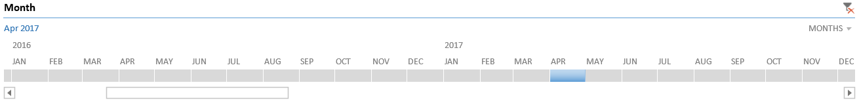
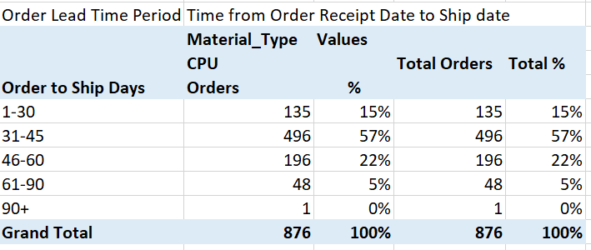
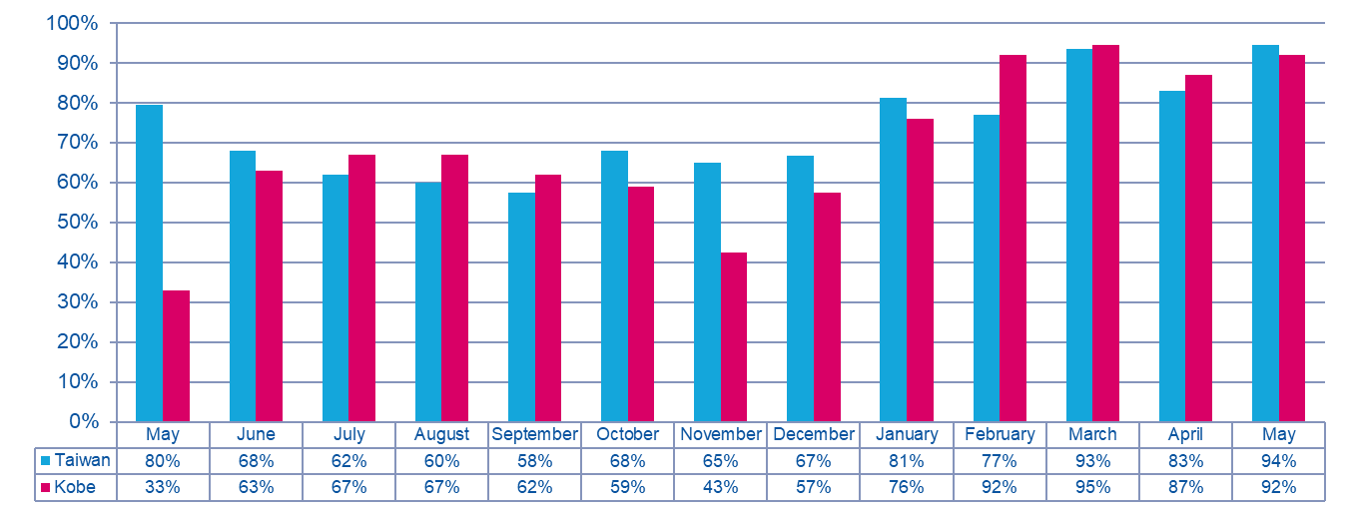
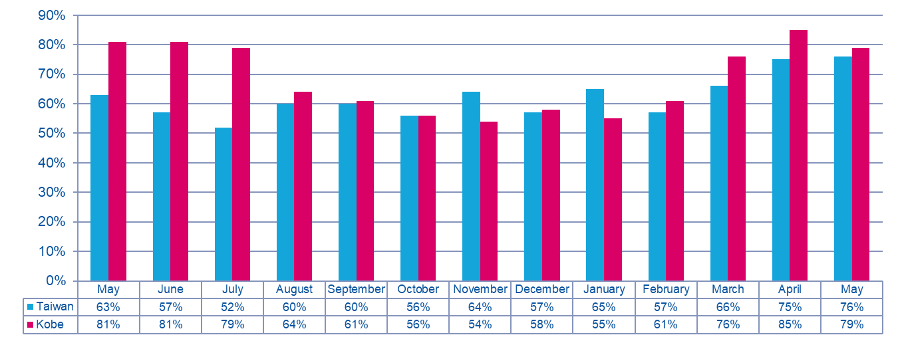
PSSNA Dashboard Update
7
ETA
Filters:
Business Unit
Product Line
Material family
Fiscal Year
Fiscal Quarter
Fiscal Month
Number of Days Orders are ETAIP 90% 2 Day Benchmark
Variance to Ship Date + or – 3 Day Benchmark

Slide 8
Control Buttons for Filtering/Selecting -Business Unit -Product Line -Material Family Monthly time selector slide bar Months = Ship Month – Show only shipped orders Order Lead Time: the number of work days/weeks between the Order Receipt Date and the Shipped Date. Ranges 1-30, 31- 45, 46-60, 61 – 90, 90+. Order Receipt date to ship date for orders shipped in the reporting month. Number of Days Orders are ETAIP 90% 2 Day Benchmark: Day ranges 0-2, 3-7, 7+ Splits by factory Count by number of days order is in ETA IP status. ETA Dates : the number of ETA dates that are created for an order = Number of ETA changes, from the initial ETA date until it is Invoiced. Ranges 1, 2, 3-5, 5+ Variance to Ship Date + or – 3 Day Benchmark: Count of Shipped orders with Ship dates within 3 days of First ETA date
Specs for ETA Page

